Slide 1
From seeing
to making.
2026 · 09
00 LAB INTRODUCTION
Dongseo University · Department of Computer Engineering
Sang-Geol Lee, Ph.D. Principal Investigator

Slide 2
From seeing
to making.
ABOUT
01 WHO WE ARE
We read the world with computer vision and rewrite it with generative models. Starting from models that understand images and video, we build the models that create them — training, deploying, and teaching them ourselves.

Slide 3
Computer Vision
01 RESEARCH
01
Where the lab began. 25 related papers.
1.1 Image and video analysis
1.2 object recognition and tracking
1.3 character recognition
1.4 medical imaging

Slide 4
Generative AI
02 RESEARCH
02
We work directly on open-source generative models and fix what needs fixing. 4 related papers.
2.1 Image and video generation and editing
2.2 diffusion models
2.3 GANs
2.4 media synthesis pipelines

Slide 5
Others
03 RESEARCH
03
We push language models beyond text: 11 related papers.
3.1 Local LLMs and agents
3.2 reinforcement learning applications
3.3 signal processing
3.4 AI education

Slide 6
Research projects · systems
02 PROJECTS
Ongoing R&D projects and systems the lab built
Project · system | Type | Period | Status
Improving Generative AI Models for Cultural Content Production | Virtual Convergence Technology Research Institute R&D | 2025 – | Ongoing
Generative AI for Content Production Workflows | Industry–academia joint R&D | 2026 – | Ongoing
Local LLM Multi-Agent System | Lab project | 2026 – | Ongoing
ComfyUI Content Generation Pipeline | Lab project | 2026 – | Ongoing
Lab AI Server | Lab project | 2026 | Completed
9 research results are listed with the papers · smartgenerationlab.github.io/en/projects.html

Slide 7
Publications
03 PUBLICATIONS
2003–2026 · Google Scholar
40
26
10
PUBLICATIONS
JOURNAL
SINCE 2024
Journal and conference papers
Journal papers
Generative AI · LLM · agents (2024–)

Slide 8
Recent activities
04 ACTIVITIES
Academic · Teaching · Lab
Website Relaunch 2026.09 · Lab
11 activities in total
smartgenerationlab.github.io/en/activities.html
ISPACS 2026 Web Chair 2026.08 · Academic
SG Lab Brand Finalised 2026.07 · Lab
Generative AI Workshop for University Staff 2026.06 · Teaching
Computer Vision System Design · Software Studio 1 · Advanced Programming 2026.03 · Teaching

Slide 9
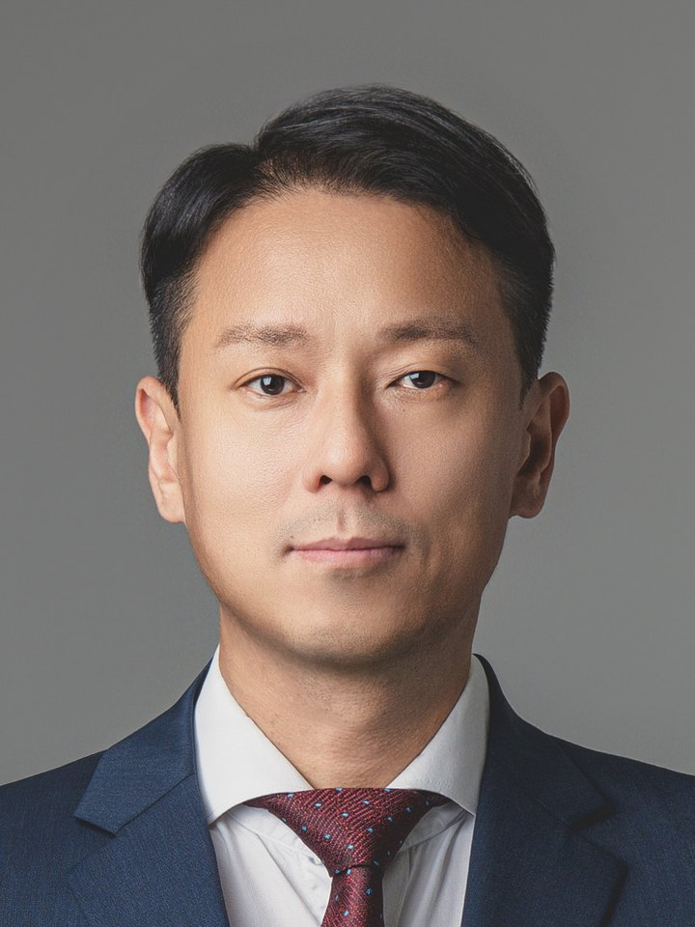
Sang-Geol Lee, Ph.D.
05 PEOPLE
이상걸 · Principal Investigator
Education
Ph.D. in Electrical, Electronic and Computer Engineering, Pusan National University
M.S. in Computer Engineering, Pusan National University
B.S. in Information and Computer Engineering, Pusan National University
Career
Associate Professor, Department of Software, Dongseo University (current)
Research Professor, WE-UP Programme, Dongguk University
Research Fellow, BK21+ Programme, Pusan National University
Interests
deep learning, machine learning, neural networks, computer vision, image processing.
leesg@dongseo.ac.kr · smartgenerationlab.github.io

Slide 10
Looking for people to
build with.
JOIN US
leesg@dongseo.ac.kr
+82-51-320-2135
Graduate and undergraduate applications, industry collaboration, and joint research proposals are all welcome by email.
smartgenerationlab.github.io/en/

